Slide 1
Evolution of Be star disks
Presentation: Erick Powell
guidance: dr. Wisneiwski

Slide 2
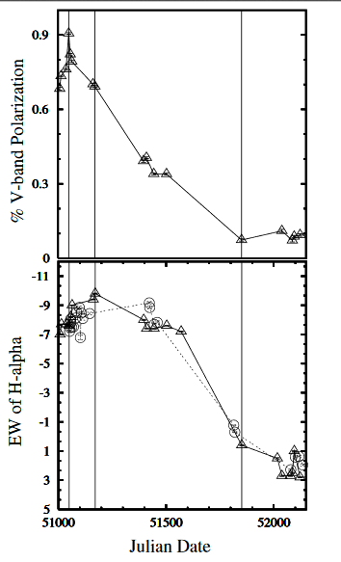
Our Goal
Be able to characterize the change in disk size over time for multiple stars
Time series analysis of light from clusters that have B-type stars
Create a catalog of the measurements needed to analyze any given star
Astrometric measurements - Hα (inner region)
Polarization (outer region)
X
A Lot

Slide 3
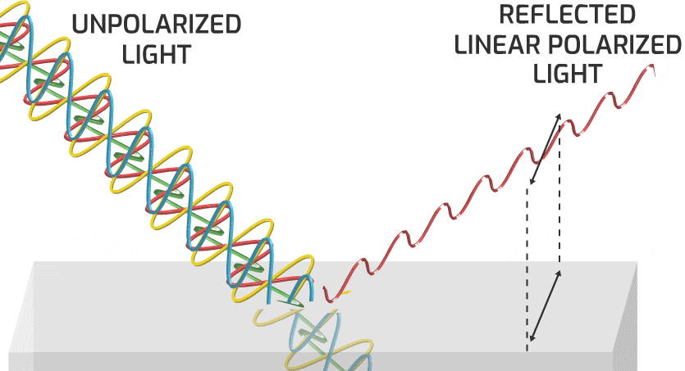
Polarization
The direction in which the electric field oscillates
Unpolarized light occurs in all rotations
Can be parametrized in four vectors (“Stokes Parameters”)
I, Q, U, and V
Specify the phase and polarization of electric field waves
Percent polarization
Lets us probe the outer part of the disk to gather information about its properties
Materials in the disk
Disk angle

Slide 4
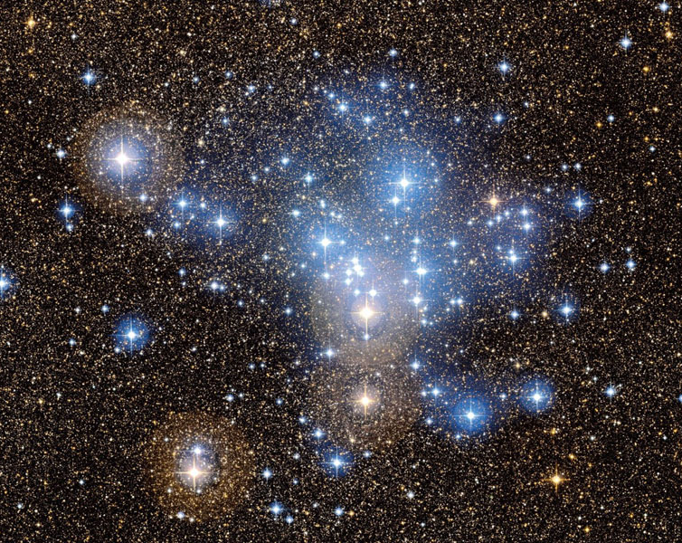
Interstellar Polarization
Biggest obstacle is isolating polarization from the disk
3 Major components to polarization
Disk - good
Space (Interstellar Polarization) - bad
Telescope itself – meh
For our measurements to be meaningful we need the polarization from disk only
Stars in the same cluster have similar space to travel through (same Interstellar polarization)

Slide 5

Future Work
Once our catalog of ISP is complete opportunity to split
Cluster based
Find ISP to different clusters
Compare ISP of different clusters
Individual star based
Find polarization of stars of a given cluster
Compare change in disk size of many stars

Slide 6
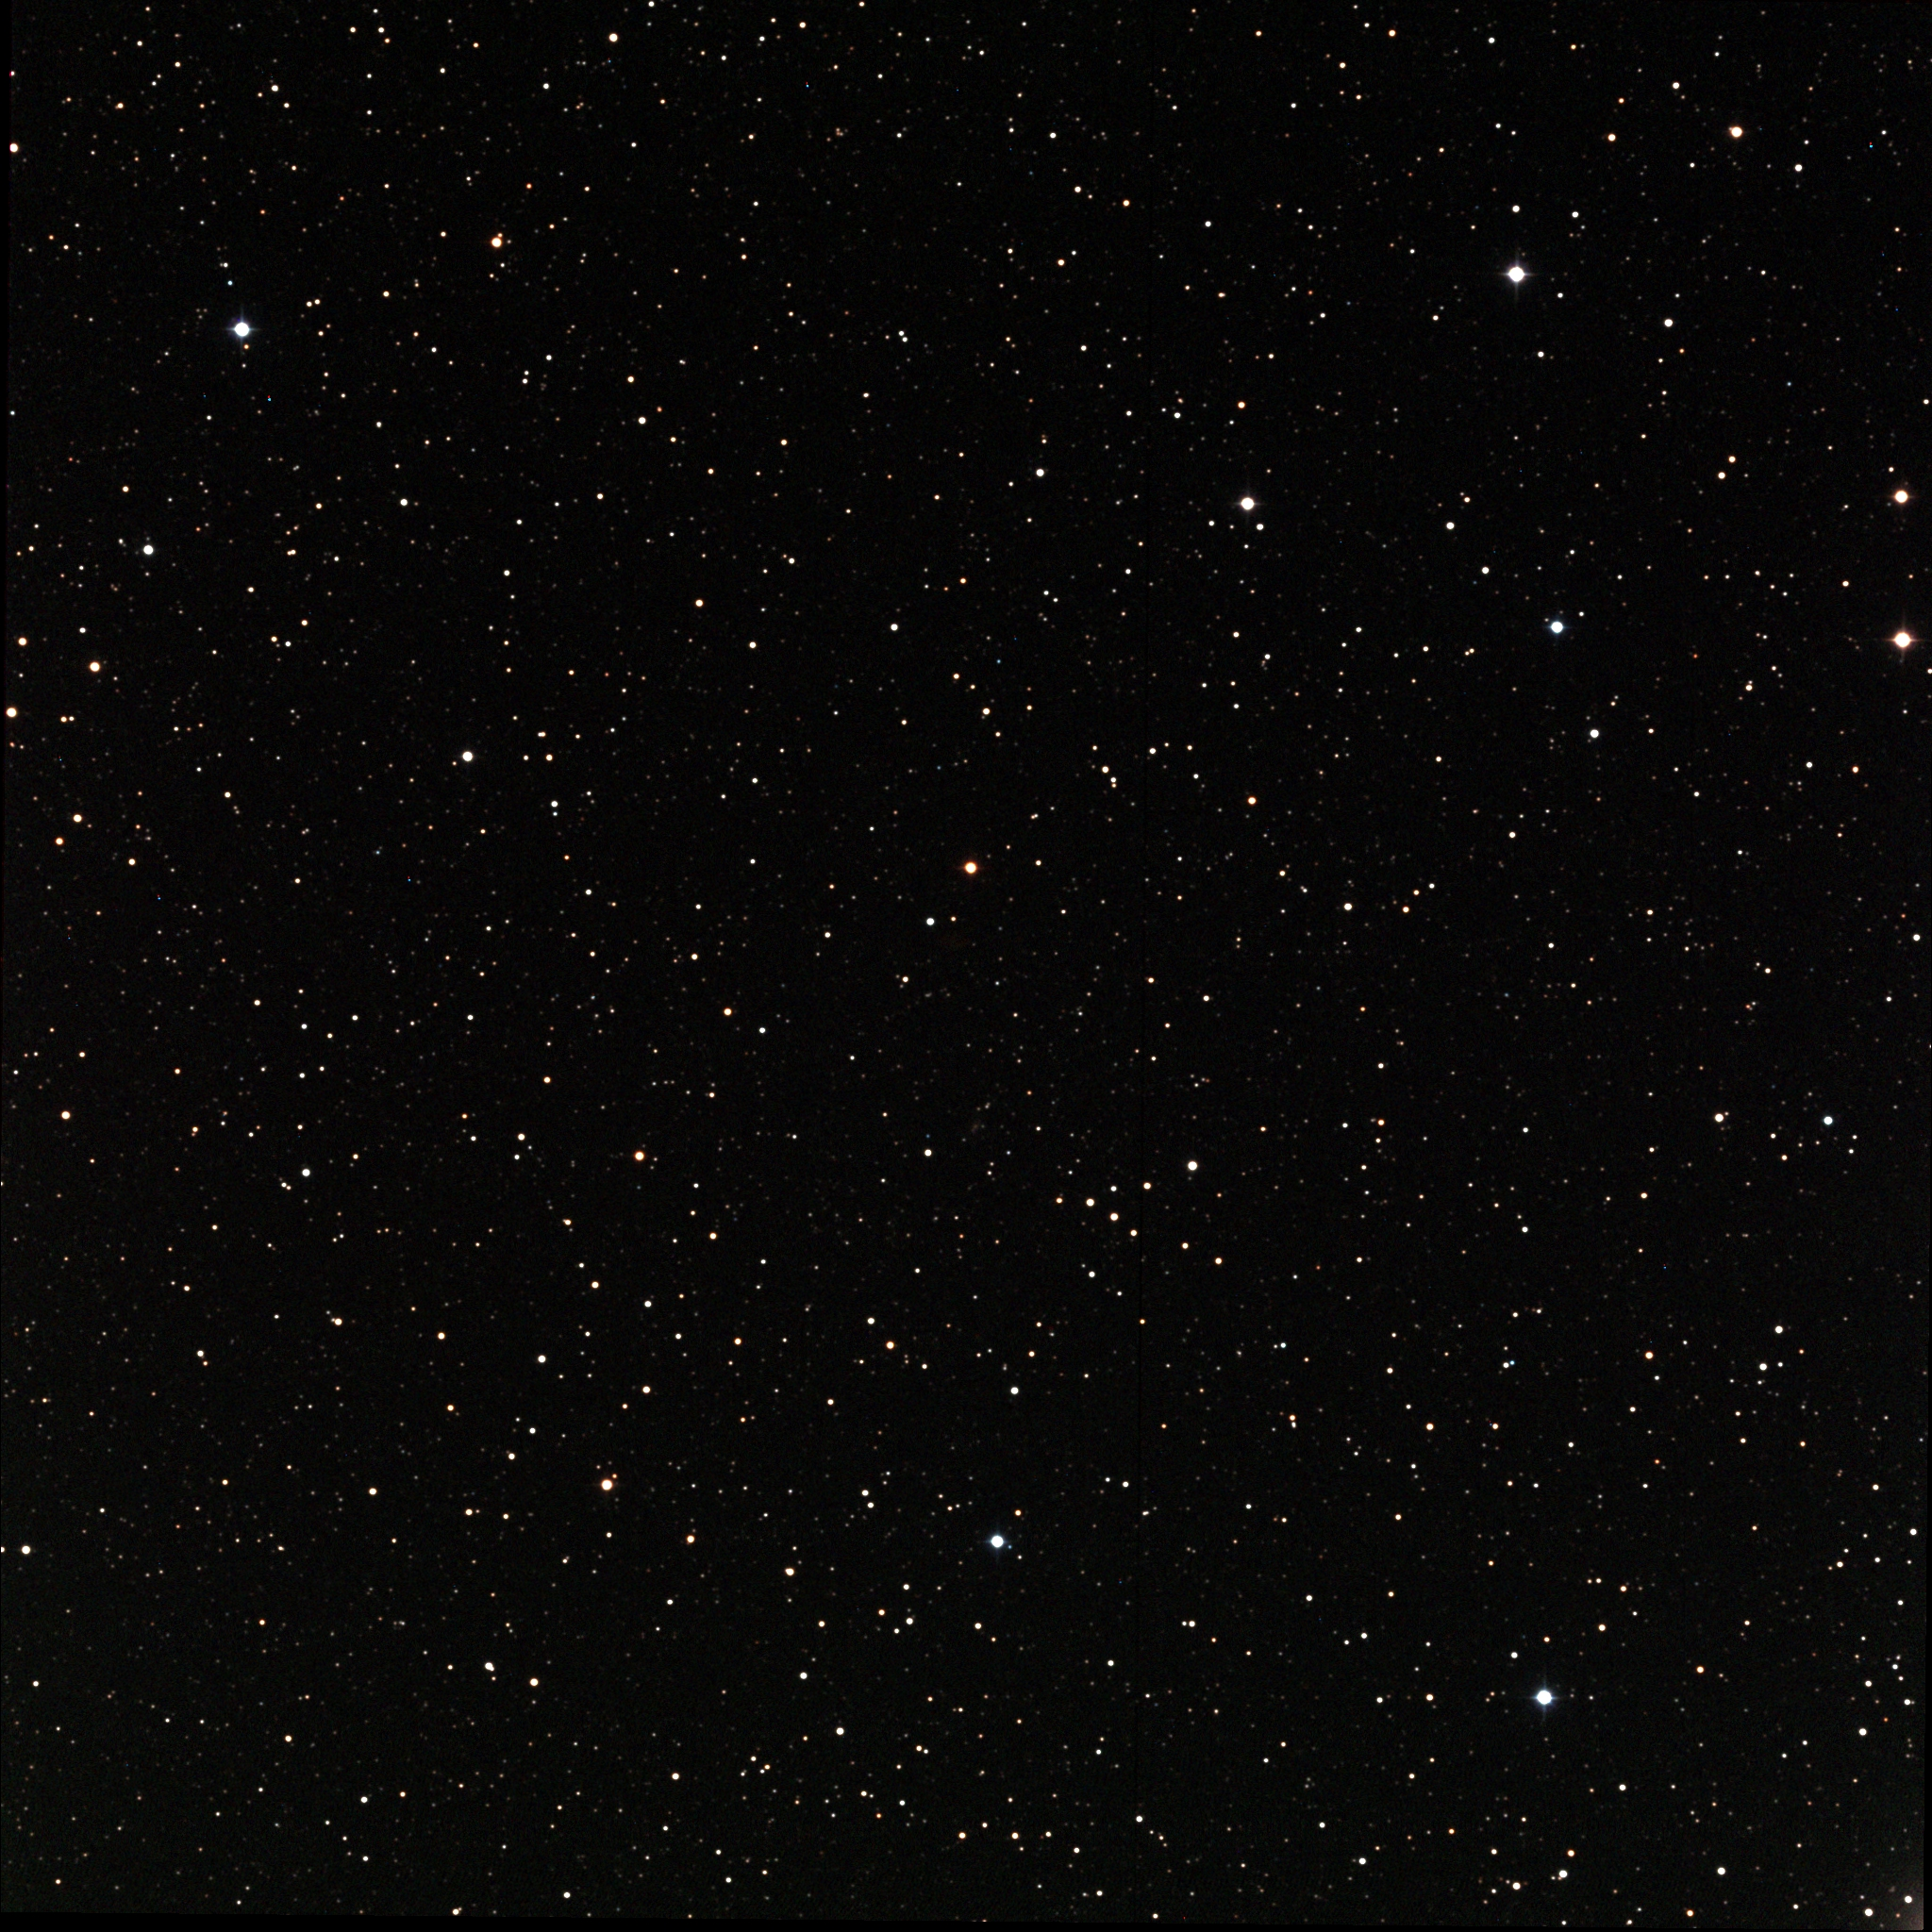
Questions?

